Slide 1
Complaint Management System
Problem Id: SGH00062
Team Id: SGH000178
College Name: Vishwakarma Govt. Engineering College, Ahmedabad.
Team Leader Name: Narendra Metaliya
College Code: 017

Slide 2
Problem Statement:
To design closed loop solution for the better complaint management. The complaint filed by user will go to the concerned authority and complete tracking of the complaint is possible. Admin, concern authorities and users can see the complaint status real time. On resolution of complain, messages (email/SMS) will be sent to respective stakeholder.

Slide 3
Abstract
Developing the one closed loop solution for complaint management. complaints filed by user will submitted to system, where analysis of complaint is followed by admin. And categorization goes to eliminate multiple complexity. At the end valid and proper complaint have to assign concerned authorities for solution and complete tracking of the complaint is made easy for user to get road to solution. In reversed all back to Administrator to what they want with solution, to display all users in system or only to specific user. Making a system with anonymous to other user but needed identity to create an account for submitting problem.

Slide 4
System Analysis About Existing System
Person must goes to Main Office for his complaint.
All the arrived complaints are submit to the Administrator.
Administrator distribute complaints among different departments according to complaint type.
Employees solve the complaints and note the complaint status in books manually.
Dispatch officer check the books and reply the solved complaints.
Inquiry officer gives the current status information of complaints from the books.

Slide 5
Limitation Of Existing System
No quick data searching facility for useful Information
Employees manually search data about complaints, which they required to process or in the case of inquiry reply.
No Proper Management of Information
Data and useful application details are capped in physical file, which itself are stored in data room. Record has most of file of different department.
Redundancy in data
There are possible to one complaint checked by one or more employee and same status reported by them. So there is possibility to data redundancy.

Slide 6
Project Scope:
Receiving peoples complaints and provides people complaint status.
Higher speed of receiving complaints.
Distribution of related complaints among different departments.
Admin will be taking care of all the departments and categories of complaints.

Slide 7
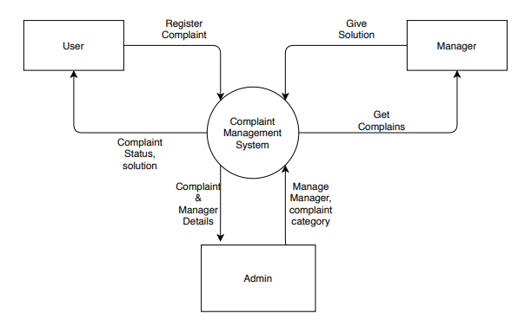
Data Flow Diagram :

Slide 8
Future scope
Data mining:
Extract all data and analysis the complaint from which most is affecting in society.
Government contract:
Involve the government section and more inspection over complaints and solution.
Multiple platforms:
Combining the platform from which we can collect from different places like social media, contact, hard post etc.

Slide 9
Thank You…

